Slide 1
Unit 3A
Human Diversity & Change
Inheritance
Gene expression

Slide 2

Study Guide
Read:
Our Human Species (3rd edtn)
Chapter 18, sections 5, 7-9
Complete:
Human Biological Science Workbook
Topic 15 – Gene Expression

Slide 3
Gene expression
Gene expression is the conversion of the genetic code carried by DNA into an end product i.e. usually a protein.
This has been fully covered in Topic 2 (Protein synthesis).

Slide 4
Promoters & terminators
The promoter is the part of a gene that contains information which turns the gene on or off. The process of transcription starts at the promoter.
The termination sequence acts like an off switch and signals to the cellular machinery that the end of the gene sequence has been reached.
Promoter sequence
Coding sequence
Termination sequence

Slide 5
Transcription
An enzyme unzips the DNA molecule exposing the nitrogen base code.
One exposed strand acts as a pattern, or template, for the construction of a molecule of messenger RNA (mRNA).
DNA polymerase works its way along the template strand and adds new nucleotides; U to A, A to T, C to G and G to C.

Slide 6
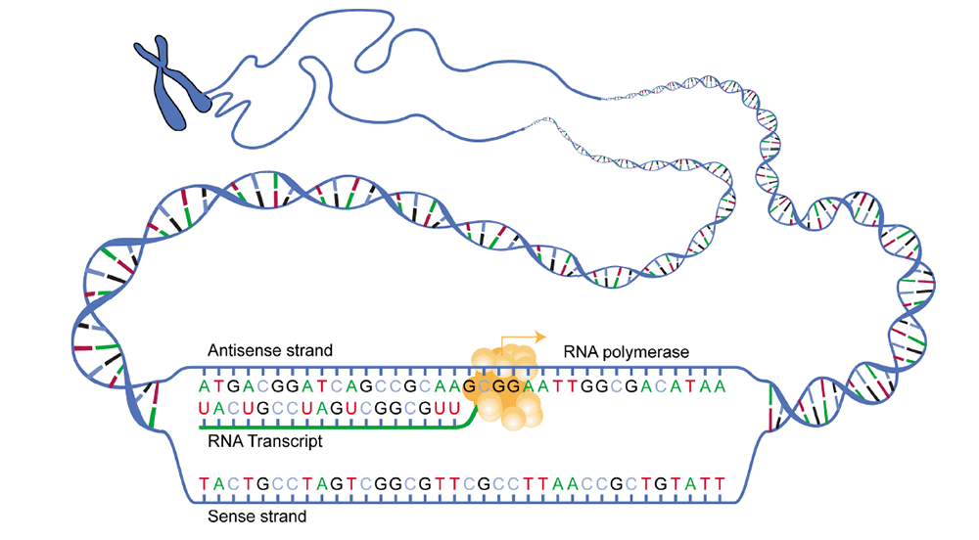
Transcription
NIH - National Human Genome Research Institute

Slide 7
Translation
Small RNA molecules (transfer RNA) transport amino acids to the ribosomes where they are assembled into proteins according to the instructions on the mRNA.
The specific order in which individual amino acids are joined to one another is determined by the sequence of the codons in the mRNA.

Slide 8
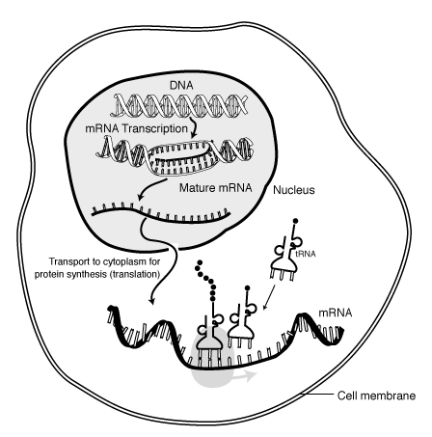
Translation
NIH - National Human Genome Research Institute

Slide 9
Regulator genes
Regulator genes produce proteins that affect the activities of other genes.
The protein produced by a regulator gene binds to a segment of DNA, known as the operator sequence, which occurs just before the start of the coding sequence.
Once bound to the operator, the protein can either stimulate or suppress the gene’s activity.

Slide 10
E. coli and the digestion of lactose
The bacterium Escherichia coli produces an enzyme β-galactosidase which digests lactose (milk sugar).
β-galactosidase is only synthesised when lactose is present – this ensures that the bacterium does not waste its resources.
β-galactosidase DNA sequence
Regulator
gene
Promoter sequence
Operator sequence
When lactose is not present a regulator gene produces a protein that binds to the promotor sequence and blocks the production of β-galactosidase.
Regulator
Promoter
Gene inactive
Repressor
protein

Slide 11
When lactose is present the lactose molecule binds to the repressor protein. The repressor protein is unable to bind to the promoter site and the bacterium is able to synthesise
β-galactosidase.
Regulator
Promoter
Gene active
Repressor
protein
Lactose
mRNA
β-galactosidase

Slide 12
Epigenetics
The term epigenetic refers to changes in gene expression that does not involve changes in the cell’s DNA but can be passed from generation to generation.
Epigenetic events explain the observation that cells with the same genotype can have more than one phenotype.
Epigenetic events generally act like an on-off switch, either silencing, or activating, a specific gene.

Slide 13
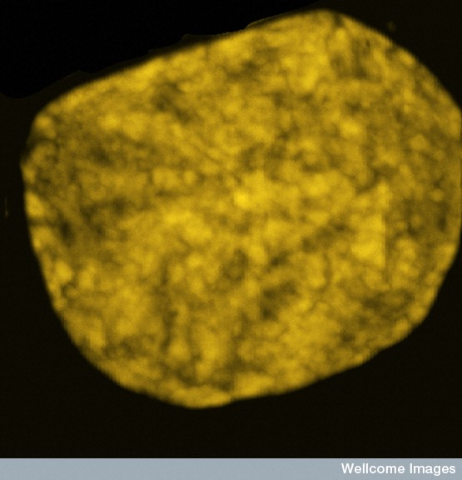
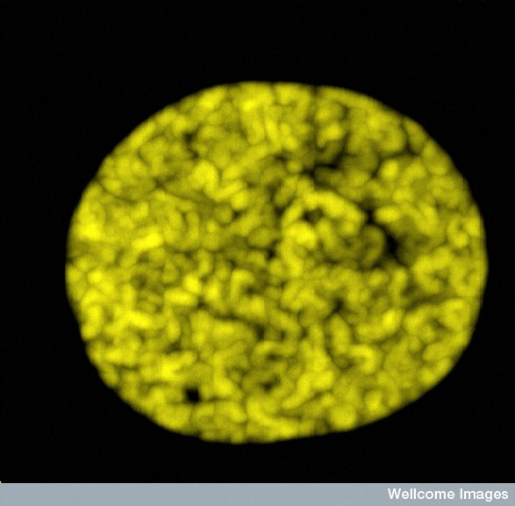
Chromatin
Matthew Daniels, Wellcome Images
Chromatin is the DNA and associated proteins (histones) that form chromosomes. Chromatin appears as dark-staining, granular material in the cell nucleus.
The above EMs show chromatin in a cell nucleus as it condenses during prophase of mitosis.

Slide 14
Histones
It is estimated that every cell nucleus contains 2-3 m of DNA.
To prevent the very fine strands of DNA becoming tangled, the filaments are coiled around special proteins called histones.
As well as organising the DNA, histones also affect gene expression.

Slide 15
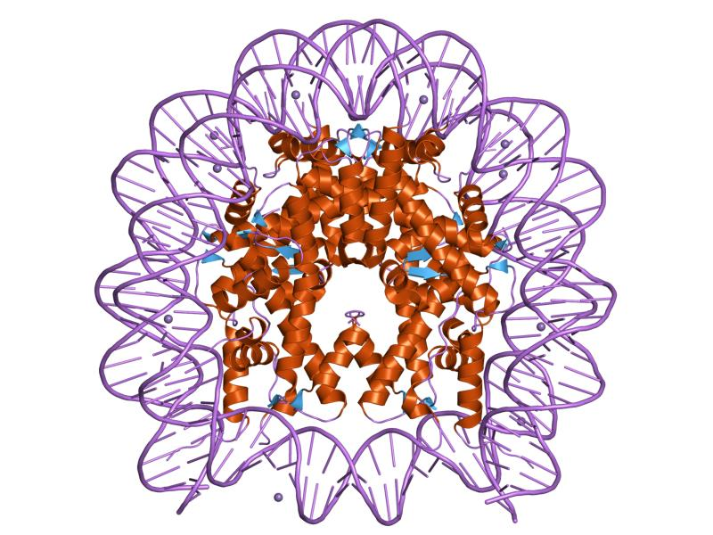
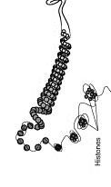
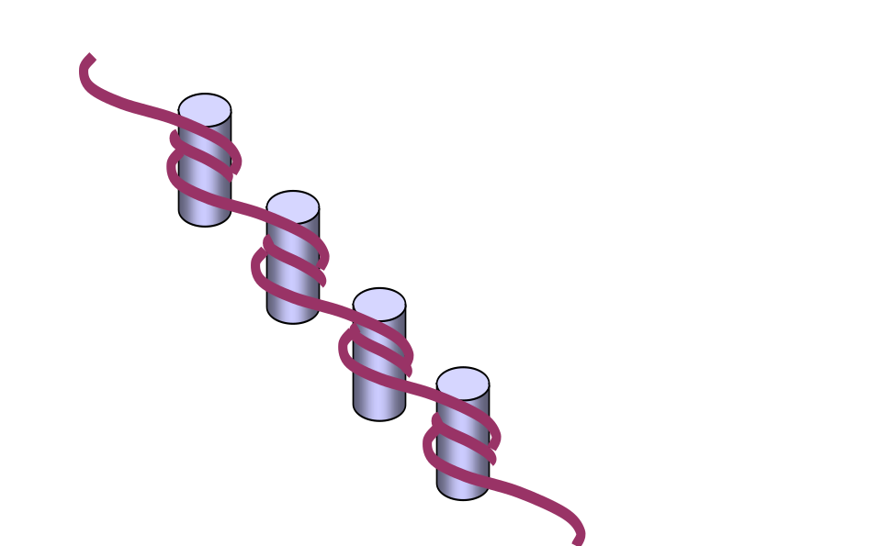
DNA coiled around histone winding frame
Histones

Slide 16
Epigenetic mechanisms
Our knowledge of epigenetic mechanisms is still developing.
DNA methylation, histone modification and prion proteins are all known to have important epigenetic effects.
Epigenetic processes are believed to be important in the development of cancer and in the differentiation of embryonic tissues.

Slide 17
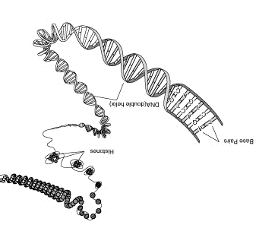
DNA methylation
Methyl tags attached to DNA bases repress gene expression
Me
Me
Histone modification
Molecules attached to the histone tails alters the activity of the DNA wrapped around them.

Slide 18
Jumping genes
Transposons (also known as ‘jumping genes’ or transposable genetic elements) are discrete pieces of DNA that can move around to different sites along a chromosome.
A large proportion of the human genome consists of transposons.

Slide 19
Transposon mechanisms
Several different types of transposons have been discovered. Some are first copied to RNA and then back to DNA before being inserted in a new location. (reverse transcription). Others use a direct ‘cut and paste’ mechanism.

Slide 20
Direct cut and paste mechanism
TRANSPOSON INSERTED
AT NEW SITE
TRANSPOSON
DNA
INSERTION
COPY OF TRANSPOSON
Retrotransponon mechanism
RETROTRANSPOSON INSERTED
AT NEW SITE
RETROTRANSPOSON
DNA
RNA
INSERTION
REVERSE TRANSCRIPTASE

Slide 21
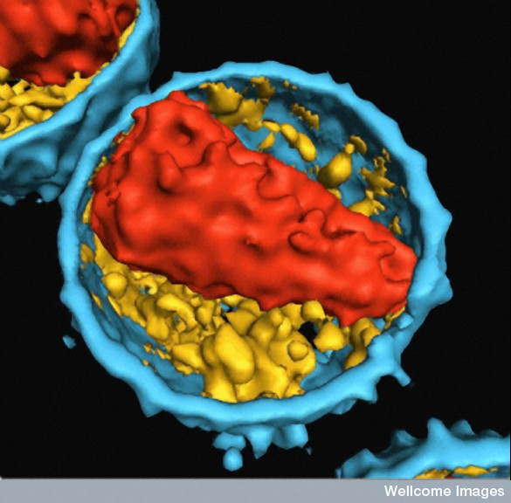
EM of a human immunodeficiency virus
Stephen Fuller, Wellcome Photo Library
Transposons can act as mutagens – i.e. they can alter gene expression. They can often activate or disable a gene but sometimes have no observable effect.
Some transposons resemble retroviruses (viruses such as those responsible for AIDS and certain cancers) and may even be derived from them.

Slide 22
Gene expression and the environment
Skin pigmentation
Skin pigmentation results from the pigment, melanin, which occurs mainly in the skin and hair follicles.
Melanin is produced in organelles called melanosomes, which occur in melanocyte cells in the basal layer of the epidermis.
Melanosomes are transferred to keratinocytes (the principal cell type in the epidermis).

Slide 23
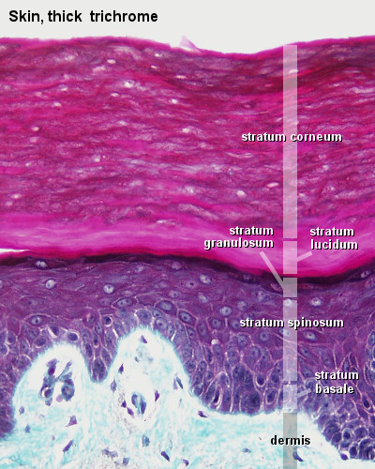
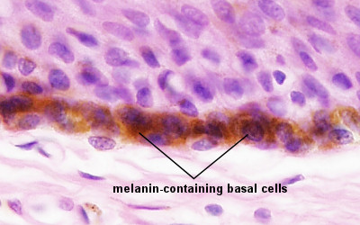
Epidermis
Lutz Slomianka, ANHB, UWA

Slide 24
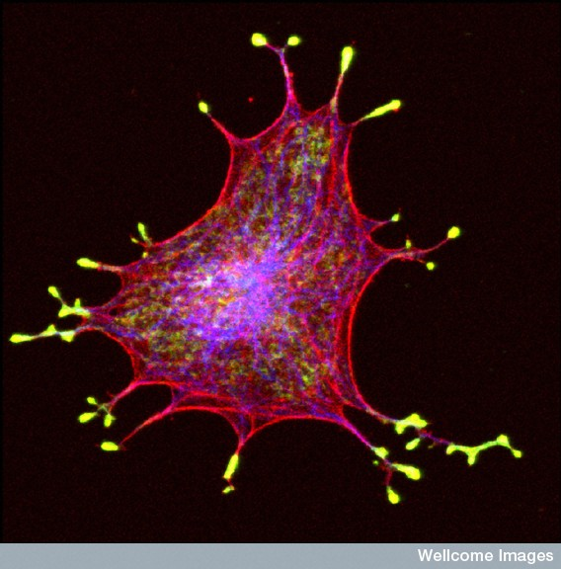
Melanocytes
Isolated melanocyte showing the
melanosomes (in yellow)
Alistair Hume, Wellcome Images

Slide 25

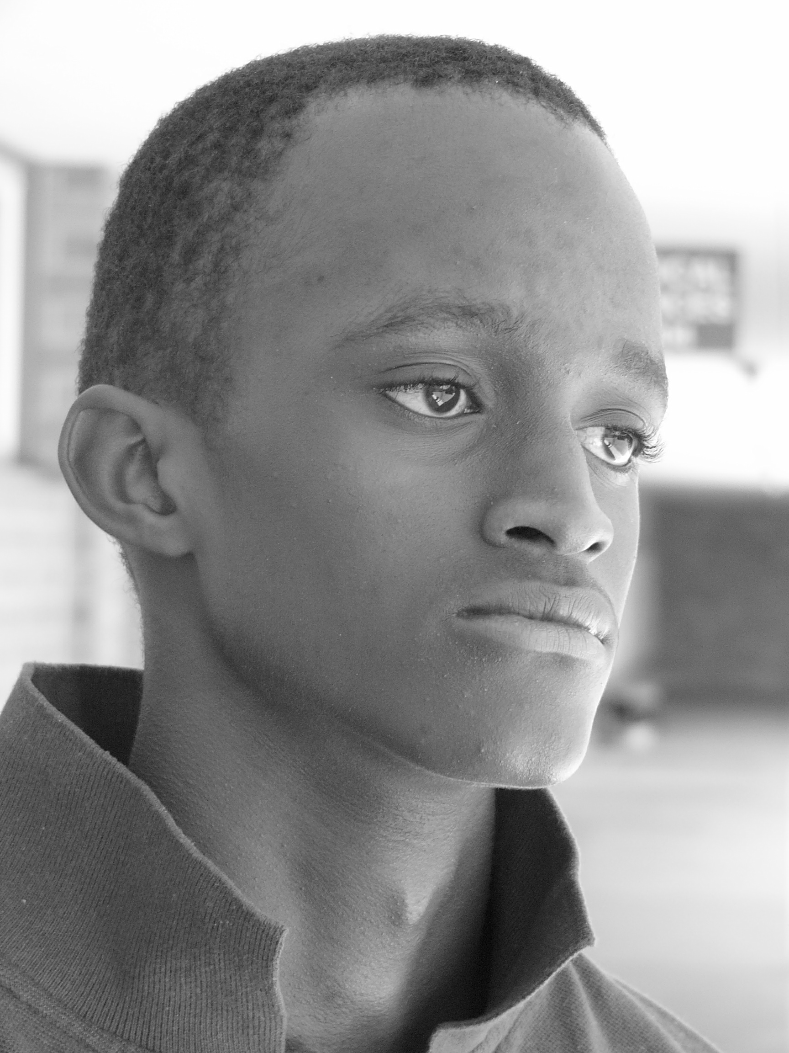
Skin colour
Skin colour depends on:
the rate of melanin synthesis
the relative amounts of brown-black pigments and red-yellow pigments
the number and size of melanosomes
the rate of transfer of melanosomes from the melanocytes to the keratinocytes

Slide 26

Tanning reaction
Ultra violet (UV) radiation in sunlight can cause severe damage to the DNA in the skin and underlying tissues.
Melanin acts like a natural sunscreen and protects the tissues from UV damage.
When exposed to UV, melanocytes are stimulated to produce more melanin. This is referred to as the tanning reaction.

Slide 27
Regulation of pigmentation
The regulation of pigmentation is very complex – to date, more than 120 genes have been identified.
When keratinocytes are exposed to the sun’s rays, they produce melanocyte stimulating hormone (MSH).
MSH stimulates receptors on the surface of melanocytes, causing them to produce more melanin.
Particularly important in the regulation of the tanning reaction are the transcription regulator proteins (regulators) MITF and p53.

